Slide 1
Discrepancy process and scope of automation

Slide 2
Why discrepancy analysis is important: Every System needs a regular discrepancy analysis process. Number of different vendor products are integrated, and it is very important to validate their collaboration. No matter an organization keep it for always or for specific duration until system gets stable and stream-lined. This analysis process can be manual or automated depends on complexity, effort, and time. Discrepancy analysis is a pro-active action to identify and resolve the issue.

Slide 3
Problem Statement
IG Team performs discrepancy analysis and execution on daily basis.
As per our regular observation, Terminated users are somehow skipped or delayed from getting processed into IIQ.
Observations
Subsequent or parent task taking longer than expected time or failure.
Downstream update not happening timely.
Incidents raised by customer for delayed/skipped termination.
Past dated termination.
Application server issue also observed sometime causing aggregation task not launched. Appendix 1.1
Time & effort gap due to manual activity of the team.
Appendix: 1.1

Slide 4
Automation possibilities
Manual process of discrepancy analysis can be automated to reduce manual effort & human errors.
this automation will include general analysis of all discrepancies and automated fix.
Specific termination discrepancies can be handled separately by automated process to fetch the terminated users from Workday report, do the comparison, and launch the SailPoint update with a check if object is free to update or not else can be queued for processing in next cycle.
We will reach-out to SailPoint with more detailed observation and artifacts, to showcase the connector problem if any.
if SailPoint provides solution since its licensed connector, well & good.
if not, our team is doing RnD on Workday APIs to check the possibilities of custom workday connector.

Slide 5
Workday Aggregation task for Terminated users (Midnight PST)
Workday File Transfer
Old tables/files containing historic data
Workday Delta Aggregation and Identity Refresh Synchronize Attributes Sequential Task
Workday Delta Aggregation
Refresh Identity Cube for Synch Attribute
Refresh Identity Cube for Role Assignment
Internal task of IIQ to find the termed users with effective end date as ‘sysdate’
Get the terminated users from WD
Replace the main file/table with latest data and take the backup of old data
4.1 Workday Bulk Aggregation Task for terminated users
4. Refresh Terminated Users Task
Store/verify the termed users in S3 bucket as file OR in custom table
Custom table or file in S3 bucket
Call SPT_IDENTITY to retrieve User Status, Employee Number, Inactive, NEEDS_REFRESH
SPT_IDENTITY table
Fetch Users from Custom table to do bulk WD Aggregation
NEEDS_REFRESH = 0
Inactive = true
Confirmed all users are refreshed with NEEDS_REFRESH = 0, Discard ‘Active’ users as they REHIRED. Accept only users with Inactive = true
update the value CUSTOM_LEAVER = 1 in custom table
Ensure all users are refreshed with NEEDS_REFRESH value 0
Feed the users in WD Bulk Aggregation & Bulk single Identity refresh task at same time
Connect IIQ DB/ Read File
OIG Bulk Aggregation Single Account
Workday Bulk Aggregation task is complete
Verification of below values from respective applications.
USER_STATUS = ACTIVE in OIG
userAccountControl = 514, bbyHREmployeeStatus = Inactive in AD
ds-pwp-account-disabled = true, bbEmploymentStatus = Inactive in OUD
EMP_TYP_CDE, EMP_STAT_CDE = Inactive in Lenel
4.2 Bulk Single Identity Refresh Task
AD Bulk Aggregation Single Account
If true
Trigger Leaver Event for those users CUSTOM_LEAVER = 1
1. Task: BBY Update Rapid Setup Attribute Task
2. Rule: WDBulkAggregation
3. Run 'Single Identity Refresh Job'
OUD Bulk Aggregation Single Account
updated the value CUSTOM_LEAVER = 1 in custom table
LENEL Bulk Aggregation Single Account
Else Exit

Slide 6
Existing Process [Manual Approach]
Performed daily after recent scheduled “Workday Delta Aggregation” task say 1:30 pm IST around.
Retrieve the terminated users from SailPoint and Workday by any one of the below two options:
List of terminated users shared by Workday team at 6pm CST.
This provides two report 1: last 60 days termination; 2nd: last 2 days termination
Users with effective end date as sysdate from SailPoint.
*** Note: 2nd option is followed if and only if team do not find workday report.
Do manual Comparison
Check Rehire cases, if yes, ignores, else selected for discrepancy execution.

Slide 7
A sort review with statistics

Slide 8
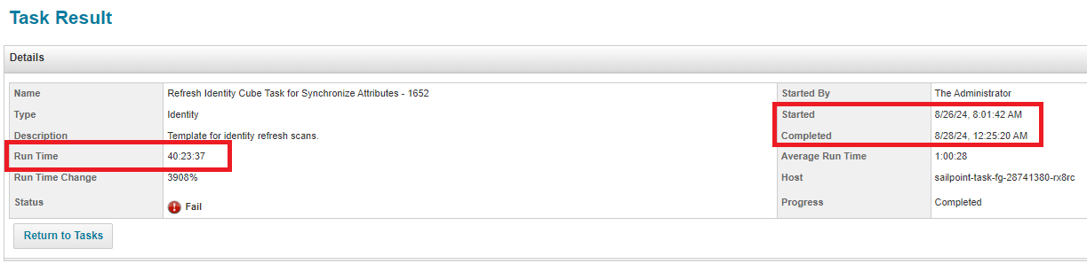
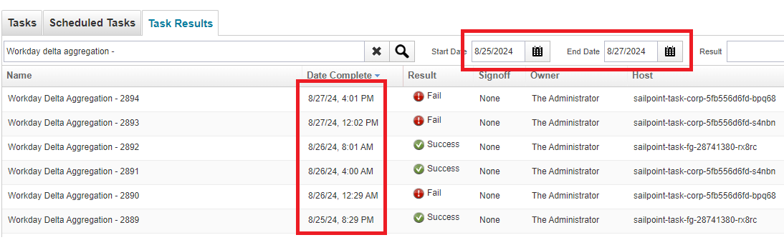
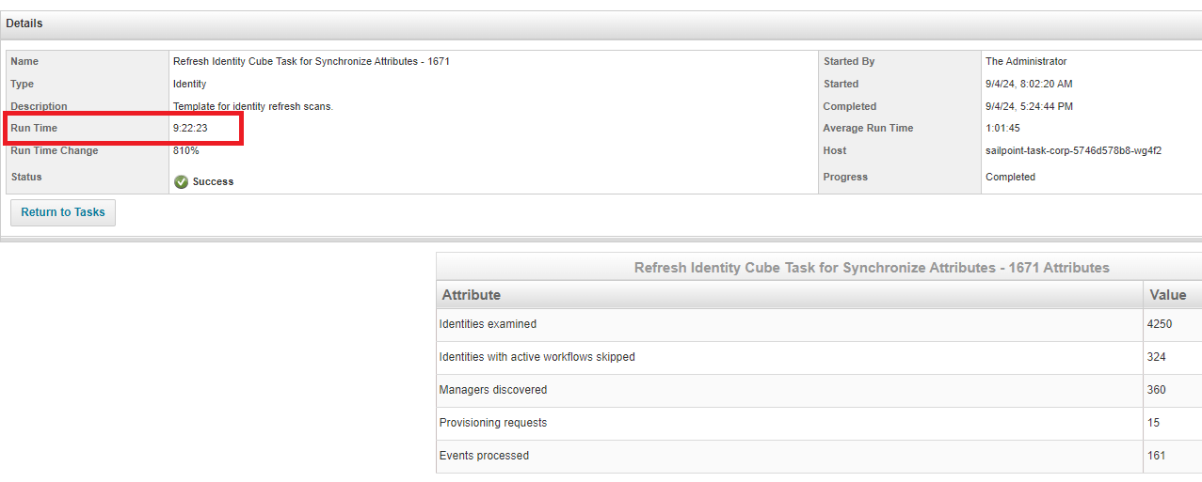
Issue due to Refresh Task
Delay in refresh of terminated users in SailPoint due to the delay of Workday Delta Aggregation and Sequential Refresh Task. Example below
Between 26th to 27th Aug, Workday Delta Aggregation task got executed only 3 times and failed to execute 2 times, because the latest refresh task took almost 40 hours to complete which eventually got finished on 28th Aug.
Another example on 4th Sept, where refresh sequential task took 9+ hours time to process 4k records which created a delay for the latest users to be refreshed in SailPoint.

Slide 9
Statistics in user level (26th – 30th Aug)
Issue Description | 26th Aug | 27th Aug | 29th Aug | 30th Aug | 31st Aug
Delay In identity refresh | 77 | 75 | 76 | 108 | 180
Users not aggregated from Workday to IIQ | 1 | 42 | 25 | 77 | 180
Leaver Event Exception | 5 | 4 | 5 | 4 | 6
Sample Data Collected from our archived reports for example (27th Aug)
Term Users |  | Term Users Active in IIQ | Term users Active in OIG | Term users Active in OIG
list |  | (WD Aggregation) | (Before Single Refresh) | (After Single Refresh & Run Leaver)
A1011745 |  | A110565 | A1011745 | A1633049
A110565 |  | A1288931 | A110565 | A3037206
A1125323 |  | A1307632 | A1125323 | A3093745
A1146977 |  | A1383481 | A1146977 | T502628
A1188188 |  | A1451206 | A1188188
A1191902 |  | A1460855 | A1275012
A1275012 |  | A1547491 | A1288931
A1288931 |  | A1566742 | A1307632
A1307632 |  | A1610145 | A1348285
A1323053 |  | A1645416 | A1383481
A1334952 |  | A1645446 | A1406809
A1344263 |  | A3028546 | A1432697
A1348285 |  | A3032008 | A1451206
A1371478 |  | A3037206 | A1460855
A1372921 |  | A3039105 | A1503411

Slide 10
Questions

Slide 11
Appendix 1.1
 | Data discrepancy Issue Incident for August Month
Example inc | Discrepancy Category | Week 1(1-3) | Week 2(4-10) | Week 3(11-17) | Week 4(18-24) | Week 5(25-31) |  | Total
INC11856655 | BoD Accounts with null job code |  | 1 |  |  |  |  | 1
INC11903823 | New Mexico users being created in SAP |  |  |  |  | 1 |  | 1
INC11858441 | Reevaluate Entitlements |  | 1 |  | 1 | 1 |  | 3
INC11853751 | Rehires/Terms Not Synced | 3 | 4 | 5 | 5 | 5 |  | 22
INC11860832 | Reprocess Breeze Accounts |  | 1 |  |  |  |  | 1
INC11828412 | User Data in OIG/AD Not Matching Workday(Manager,jobcode,location) | 3 | 4 | 5 | 5 | 5 |  | 22
INC11896388 | Remove Role from User |  |  |  | 1 |  |  | 1
 |  |  |  |  |  |  |  | 51

Slide 12
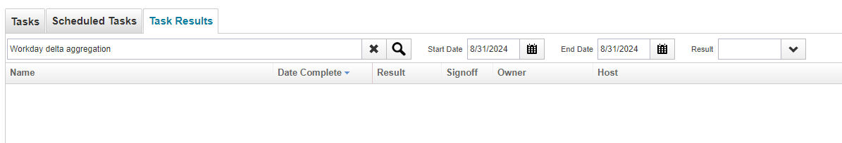
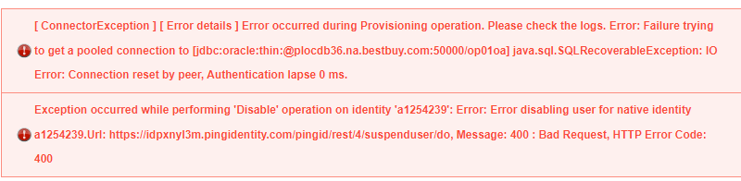
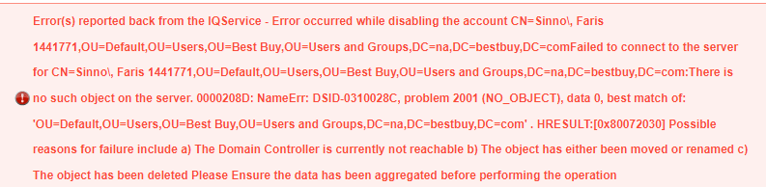
Appendix 1.2
On 31st Aug, Workday delta sequential task didn’t run for single time because from 30th Aug evening, the servers were inactive, and no tasks were running at that time. Restarted the servers resolved the issue.
SailPoint Connector Exception while connecting target system during the rapid setup leaver task. Example, User not available in target while triggering the Leaver Event

Slide 13
Thank you.

Slide 15
Business Benefit
Assurance from end to end that no terminated user is present anymore in downstream application.
Manual Effort of discrepancy fix can be removed.
Past 6 month's data
Manual Activity | Discrepancy Type | Effort(hour) per Activity |  | last 6 Months count |  |  |  |  |  | Total Effor in last 6 month | Monthly aferage effort
Incident |  |  |  | Aug | July | June | May | Apr | Mar
 |  |  | Count | 22 | 21 | 18 | 12 | 22 | 23
 | Rehired | 2.5 | Total Effor per month | 55 | 52.5 | 45 | 30 | 55 | 57.5 | 295 | 49
 | Terminated | 1 |  | 22 | 21 | 18 | 12 | 22 | 23 | 118 | 20
Discrepancy Fix
 |  |  | Days | 20 | 20 | 20 | 20 | 20 | 20
 | Rehired | 2.5 | Total Effor per month | 50 | 50 | 50 | 50 | 50 | 50 | 300 | 50
 | Terminated | 1 |  | 20 | 20 | 20 | 20 | 20 | 20 | 120 | 20

Slide 16
Move to Next user
Workday Delta Aggregation and Identity Refresh Synchronize Attributes Sequential Task
Workday
Sends the terminated users’ report in 12pm PST
Single Account Workday Aggregation
S3 bucket
4. Termination discrepancy fix custom task
Retrieve single identity
Custom Table
5. Run Target Aggregation Task
Single Identity Refresh
Store User in Custom Table
Trigger Leaver Event
If user Active
5.1 Run Single Identity OIG Aggregation
5.2-4 Run Single Identity AD/OUD/Lenel Aggregation

Slide 17
Key changes in Automation Steps
Creation of Custom table/file with custom column along with selective attributes which will hold only terminated users for the day.
Run Full Workday Aggregation for all those users irrespective of manual validation in Workday in manual discrepancy fix
Run single identity refresh for all those users irrespective of manual validation in downstream application.
Run Bulk Account Aggregation of all downstream applications instead of manual checks in each applications.

Slide 18
Root Cause (Cont.)
Workday don’t include the past terminated users’ details in their daily termed users’ report.
Long running FG instances create obstacle in auto launching of scheduled sequential tasks.
SailPoint Connector Exception while connecting target system during the rapid setup leaver task.
User not available in target while triggering the Leaver Event

Slide 19
Workday Aggregation task for Terminated users (Midnight PST)
Workday File Transfer
Old tables/files containing historic data
Workday Delta Aggregation and Identity Refresh Synchronize Attributes Sequential Task
Workday Delta Aggregation
Refresh Identity Cube for Synch Attribute
Refresh Identity Cube for Role Assignment
Internal task of IIQ to find the termed users with effective end date as ‘sysdate’
Get the terminated users from WD
Replace the main file/table with latest data and take the backup of old data
4.1 Workday Bulk Aggregation Task for terminated users
4. Refresh Terminated Users Task
Store/verify the termed users in S3 bucket as file OR in custom table
Custom table or file in S3 bucket
Call SPT_IDENTITY to retrieve User Status, Employee Number, Inactive, NEEDS_REFRESH
SPT_IDENTITY table
Fetch Users from Custom table to do bulk WD Aggregation
NEEDS_REFRESH = 0
Inactive = true
Confirmed all users are refreshed with NEEDS_REFRESH = 0, Discard ‘Active’ users as they REHIRED. Accept only users with Inactive = true
update the value CUSTOM_LEAVER = 1 in custom table
Ensure all users are refreshed with NEEDS_REFRESH value 0
Feed the users in WD Bulk Aggregation & Bulk single Identity refresh task at same time
Connect IIQ DB/ Read File
OIG Bulk Aggregation Single Account
Workday Bulk Aggregation task is complete
Verification of below values from respective applications.
USER_STATUS = ACTIVE in OIG
userAccountControl = 514, bbyHREmployeeStatus = Inactive in AD
ds-pwp-account-disabled = true, bbEmploymentStatus = Inactive in OUD
EMP_TYP_CDE, EMP_STAT_CDE = Inactive in Lenel
4.2 Bulk Single Identity Refresh Task
AD Bulk Aggregation Single Account
If true
Trigger Leaver Event for those users CUSTOM_LEAVER = 1
1. Task: BBY Update Rapid Setup Attribute Task
2. Rule: WDBulkAggregation
3. Run 'Single Identity Refresh Job'
OUD Bulk Aggregation Single Account
updated the value CUSTOM_LEAVER = 1 in custom table
LENEL Bulk Aggregation Single Account
Else Exit

Slide 20
Observations
Delay in refresh of terminated users in SailPoint due to delay in Workday Delta Aggregation and Sequential Refresh Task.
Past terminated users are not included in Workday daily termination report. Workday create separate ticket for SailPoint to take care such issues. Sample incident# INC11855361, INC1185362 where user#A3081468 and A3071545 terminated more than 60 days in past
Delay in auto launching of Workday Delta Aggregation Task – Restart of servers resolve this issue
SailPoint Connector Exception while connecting target system during the rapid setup leaver task.
User not available in target while triggering the Leaver Event.

Slide 21
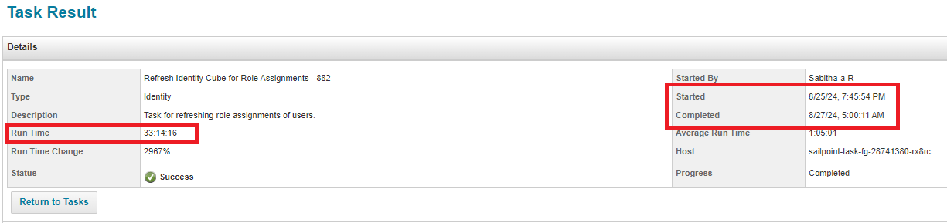
Key issues highlighted in 26th – 31st Aug
On 26th Aug, Workday Delta Aggregation task didn’t execute more than 3 times, because the following refresh task took 40 hours to complete, and it was finished 2 days later. This is Delay In Identity Refresh Task.
On 26th Aug, Refresh Task for Role Assignment didn’t execute for single time, because the previous Role refresh task took Almost 33 hours, and it was finished 2 days later. This is Delay In Refresh Task in role assignment.
On 31st Aug, Workday delta sequential task didn’t run for single time because from 30th Aug evening, the servers were inactive, and no tasks were running at that time. Restarted the servers resolved the issue

Slide 23
Automation Solution
Workday team will manually push the terminated user list in SailPoint server.
Create a custom task at 2am CST everyday. This task will read the data from the terminated users’ list shared by Workday.
Create a custom file in SailPoint server and store those users with selective attributes (User Status, Employee Number, Inactive, NEEDS_REFRESH) in that custom table/file.
Run sequentially “Bulk Workday Aggregation” and “Bulk Single identity Refresh” task for the users stored in custom table.
Ensure all those users are Aggregated and Refreshed, Discard the ‘Active’ users and consider ‘Inactive’ users.
Run sequential downstream application (OIG, AD, OUD, Lenel) Aggregation task to get the latest status of those users in SailPoint.
If those users are found as ‘Active’ after Aggregation, then auto trigger Leaver event for those users again

